Slide 1
Using Google Apps at
Coonabarabran High
2013
An introduction to new DEC-approved tools for staff and students

Slide 2
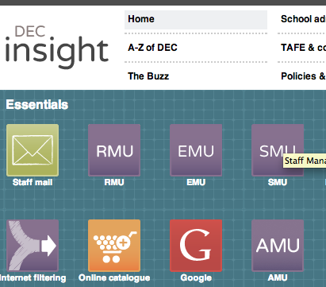
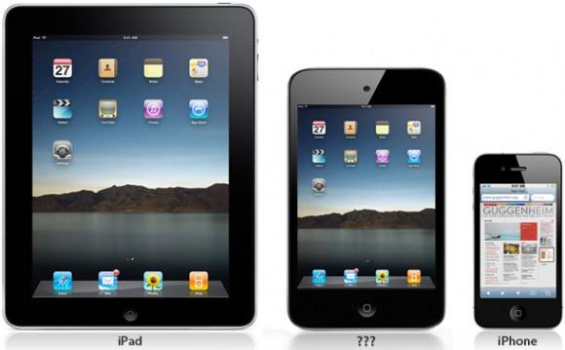
What is Google Apps?
It’s a simple and easily accessible way to store and edit documents and other files online.
Notes:
It is available on any Internet-connected computer you can access.
It’s through the portal, so standard login, no extra username/passwords to remember.
No more worry about where files are stored, or accessing servers, or losing USB drives.

Slide 3
A new way to collaborate in the classroom
One to one collaboration
Small group collaboration
Whole class collaboration
Notes:
Even collaborate with groups in other schools
All through a simple web browser interface

Slide 4
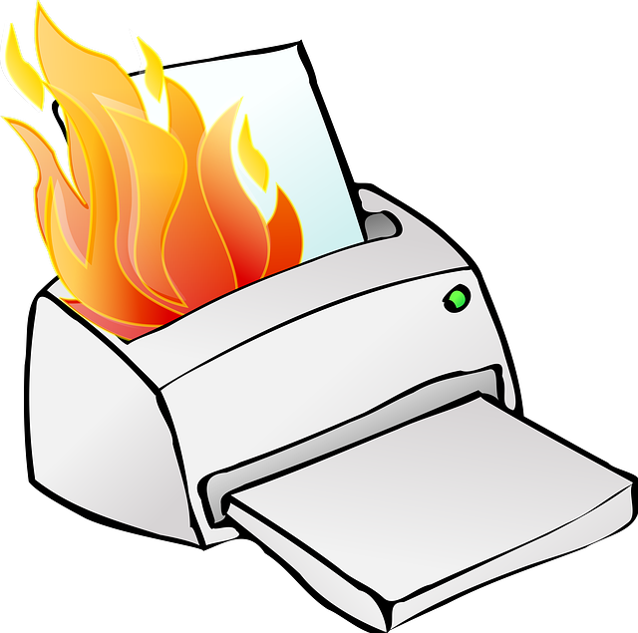
Eliminate printing!
There is no need to print documents created on computer!
Notes:
There is no need to print documents created on computer.
The student can simply share the document with their teacher to get work marked or checked.
The teacher can manage their marking digitally, and have full access to adding comments or notes to the student’s document.

Slide 5
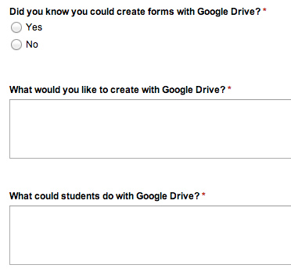
Other Apps tools
Google Forms -- create quick online forms that can be used as student surveys or quizzes or feedback.
Notes:
Compile into Google Spreadsheets for easy data collection, requiring less work from you.
Extensions to this such as Flubaroo can help you compile and mark quizzes even more easily than with Forms alone.

Slide 6
Google Presentation
This presentation, of course,
is made with the
Apps Presentation tool!

Slide 7
Google Sites
A related tool that allows you to create website content with anything you like.
This would be perfect for class presented notes or worksheets (and another excuse to use less paper!)
Notes:
Students cannot create Sites, but they can edit a Site if you give them permission -- another avenue for group collaboration.

Slide 8
Google Docs Drawing
A full suite of tools to add images to document. Good for science, maths, mindmapping in English, or any work with visual elements.
Draw some
attention!

Slide 9
Workflow suggestion
There will be nearly 100 laptops used a "shared" devices in the school this year, in addition to the 300+ devices already in student (and staff) hands.
We know there are issues -- hard to access server shares, especially on shared machines, and USB drives always go missing or break.

Slide 10
Google Apps is designed to improve over both of these options.

Slide 11
Better than the school server
Accessible on any machine with a web browser and Internet access. At home or school.
This includes all desktops, laptops, even mobile devices such as iPads and iPhones, or Android phones.
No worries about server mapping, or word processing formats.

Slide 12
Better than USB drives
USB drives break down. More than people like to admit.
And students lose them. All the time.
Google Apps is "cloud" storage through the portal. One login only. You can't lose it!
No more excuses!

Slide 13
One of the best advantages?
Saving is automatic!
That's right -- documents are automatically saved to the drive every time you make an edit. This removes student excuses for missing work, and even helps us with blackouts or other issues that have been known to cause delays in work being delivered.

Slide 14
Yes, you need Internet access
This is the only significant equity issue. But it's only an issue for at-home work.
We need to survey more, get a better idea of how many students do not have Internet access at home.
But even then, there is offline access for editing, and even the "worst" Internet is enough (dial-up or satellite).

Slide 15
Workflow model
Previously, students created work on a computer and printed it. Even then, laptops were hard to configure for printer access. And you're left with loads of paper. Paper that costs the school thousands of $ per term.
This can change

Slide 16
Workflow model
With Google Apps, students can create documents at will through the portal, where they are saved automatically.
They can create solo documents, or collaborate with fellow students.
They can do this at school, or home, or anywhere in-between with the right device.

Slide 17
Workflow model
When their teacher needs to see the work, a simple process allows them to share it with their teacher.
A few clicks, and the document will automatically show up in the teachers Google Apps, ready for marking.
It's that easy

Slide 18
Workflow model
Once a teacher has the documents, you can move them into class folders, making organisation easy.
You can mark the work online, again without having to print.
You can edit directly, or add comments by highlighting sections, or comments on the whole document.

Slide 19
Workflow model
This is a digital workflow for a digital age.
It saves on paper and saves on administration and if done correctly is a total game-change for the school environment. It allows students to keep their work organised no matter what computer (or mobile device) they use, and allows a new kind of collaboration.

Slide 20
Fears? Problems? Issues?
You can probably see the main issue:
Students can create documents whenever they like, and share them with other students whenever they like, and never share them with teachers. And those documents could contain all sorts of content...
So?

Slide 21
Completely true!
Except:
Everything a student creates is tagged with their name. Every edit, every collaboration.
There is no such thing as an anonymous document.
Students are responsible for what they create, and they will be held to that.

Slide 22
Issues
Students must know that any negative use of the tools will catch up with them
This is a valuable lesson for digital citizenship, and an area that will only become a bigger issue as they get older, not a smaller one.
It's something they need to learn now!

Slide 23
So Google Apps is?
A new way for staff and students to create work, collaborate and coordinate how they work.
It can minimise or eliminate printing and change the digital workflow, cutting down on mistakes and excuses for late work.
Available through the portal, using the same single log-in we already have. So much easier!

Slide 24
The last problem is:
The department has not given us a date for the Apps to go live on the portal!
We have been given an idea that it may be as soon as week 3-4 of term 1, but there has been no official announcement as yet.
So stay tuned!

Slide 25
Any questions?
Notes:
Make sure I show sample document with main features here, if I haven't already.

